Slide 1

Blood Bank Management System
Presented by:
Md Razib Hossain
Id:UG02-49-18-005

Slide 2

Purpose:
The purpose of the blood bank management system is to simplify and automate the process of searching for blood in case of emergency and maintain the records of blood donors ,recipient ,blood donation programs and blood stocks in the bank.

Slide 3
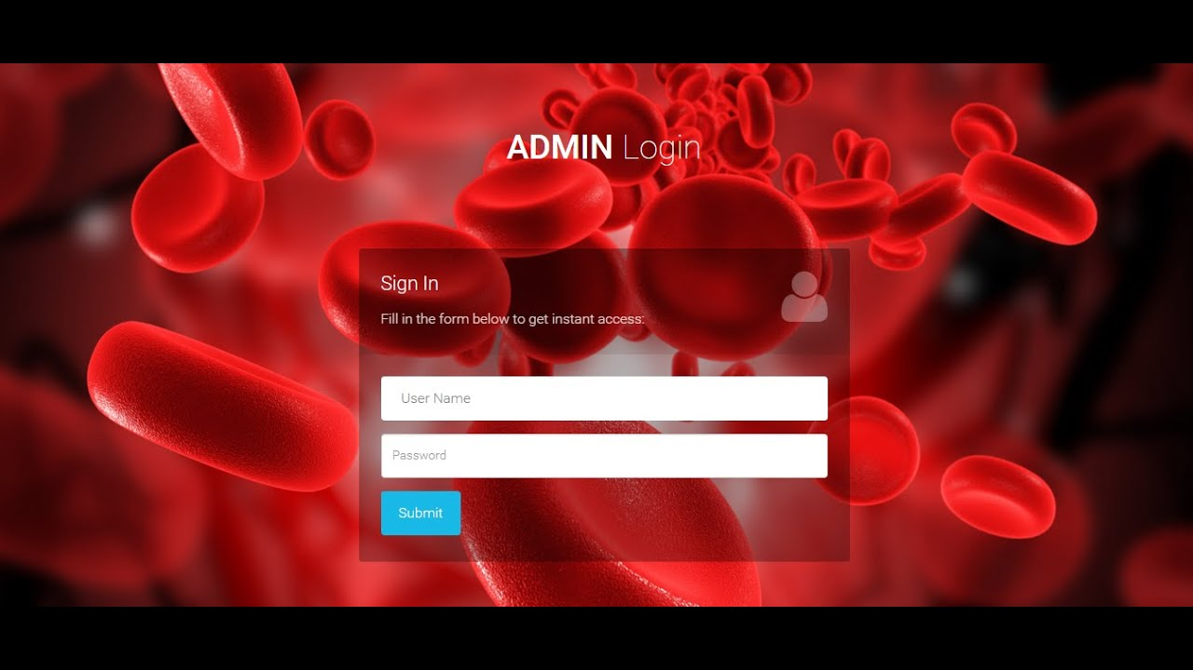

Slide 4

Introduction:
A blood donation is a process whereby a person voluntarily has blood drawn to be used for future transfusions when in need at hospitals for treatment procedures that require them. Donation may be of whole blood (blood drawn directly from the body) or of specific components of the blood; such as red blood cells, white blood cells, plasma, and platelets. Blood banks often participate in the process of collecting blood and other procedures such as managing stocks, approving blood requests and updating donation information.

Slide 5

Data about Donor and recipient Id:
Donation Program
1.Donor/Recipient id
2.Name
3.Date of birth
4.Sex
5.Blood Group
6.Address
7.Contact number
8.Email Address
9.Blood id
10.Event id
1.Organizer
2.Event id
3.Date of Donation
4.Venue
5.Volunteers
6.Amount of blood collected
Staff
Blood
1.Blood id
2.Blood Group
3.Date of collection
4.Expire date
1.Staff id
2.Name
3.User Name
4.Password

Slide 6
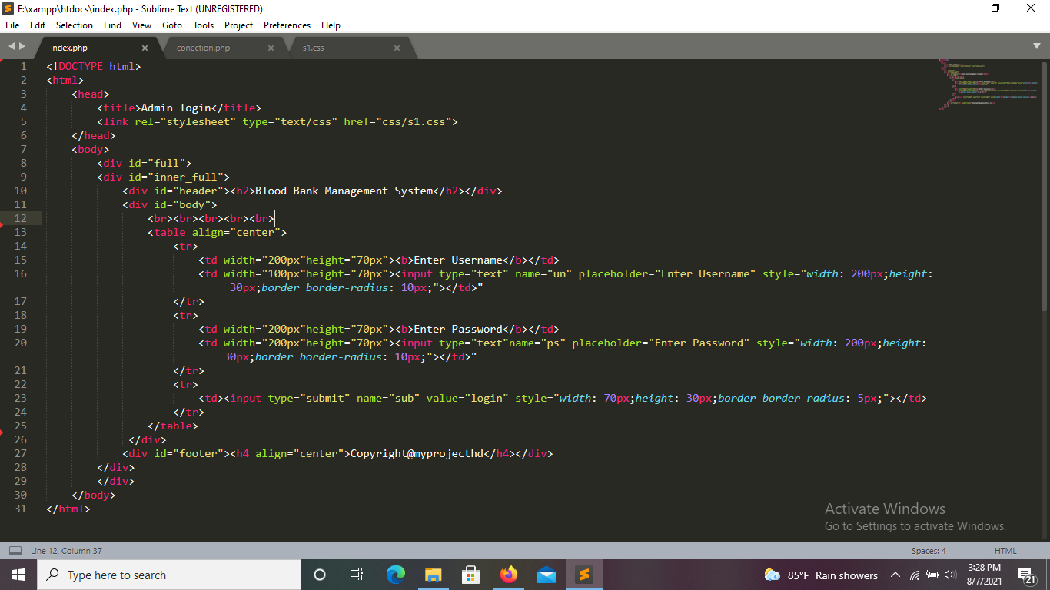
CODE:index.php

Slide 7
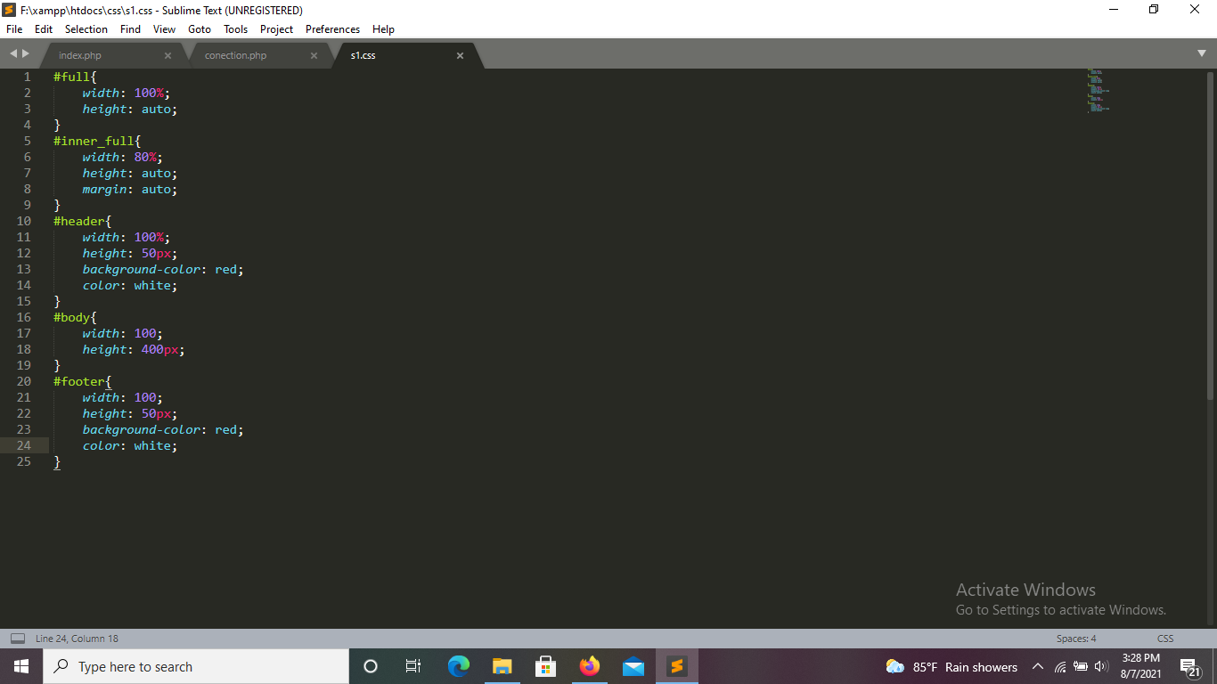
CODE:s1.css

Slide 8

Software Requirements:
Operating System – Windows 7 or HigherApache Server
(UWAMP/XAMMP)
Bootstrapphp
Myadmin
HTML
SUBLIN TEXT
Cascading Style Sheet(CSS)

Slide 9

Thank You

